Slide 1
Dependency Inversion Principle (DIP)
The Dependency Inversion Principle states that:
High level modules should not depend upon low level modules. Both should depend upon abstractions.
Abstractions should not depend upon details. Details should depend upon abstractions.
The Dependency Inversion principle (DIP) helps us to develop loosely couple code by ensuring that high-level modules depend on abstractions rather than concrete implementations of lower-level modules. The Inversion of Control pattern is an implementation of this principle

Slide 2
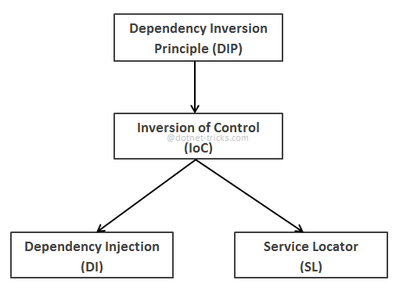
Inversion of Control (IoC)
The term Inversion of Control (IoC) refers to a programming style where a framework or runtime, controls the program flow. Inversion of control means we are changing the control from normal way. It works on Dependency Inversion Principle.

Slide 3
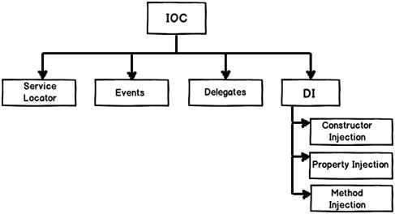
Dependency Injection (DI)
DI is a software design pattern that allow us to develop loosely coupled code. DI is a great way to reduce tight coupling between software components. DI also enables us to better manage future changes and other complexity in our software. The purpose of DI is to make code maintainable.
The Dependency Injection pattern uses a builder object to initialize objects and provide the required dependencies to the object means it allows you to "inject" a dependency from outside the class.

Slide 4
Overview of Spring Framework
The Spring Framework is a lightweight solution and a potential one-stop-shop for building your enterprise-ready applications. However, Spring is modular, allowing you to use only those parts that you need, without having to bring in the rest. You can use the IoC container, with any web framework on top, but you can also use only theHibernate integration code or the JDBC abstraction layer. The Spring Framework supports declarative transaction management, remote access to your logic through RMI or web services, and various options for persisting your data. It offers a full-featured MVC framework, and enables you to integrate AOP transparently into your software.
Spring is designed to be non-intrusive, meaning that your domain logic code generally has no dependencies on the framework itself. In your integration layer (such as the data access layer), some dependencies on the data access technology and the Spring libraries will exist. However, it should be easy to isolate these dependencies from the rest of your code base.

Slide 5
Getting Started With Spring
Spring Framework is a Java platform that provides comprehensive infrastructure support for developing Java applications. Spring handles the infrastructure so you can focus on your application.
Spring enables you to build applications from "plain old Java objects" (POJOs) and to apply enterprise services non-invasively to POJOs. This capability applies to the Java SE programming model and to full and partial Java EE.
Examples of how you, as an application developer, can use the Spring platform advantage:
Make a Java method execute in a database transaction without having to deal with transaction APIs.
Make a local Java method a remote procedure without having to deal with remote APIs.
Make a local Java method a management operation without having to deal with JMX APIs.
Make a local Java method a message handler without having to deal with JMS APIs.

Slide 6
Simple spring application
These applications are like any Java application. They are made up of several classes, each performing a specific purpose within the application. But these classes are configured and introduced to each other through an XML file. This XML file describes how to configure the classes, known as theSpring configuration file.
Spring configuration file is an XML file. This file contains the classes information and describes how these classes are configured and introduced to each other.
This concept says that you do not create your objects but describe how they should be created. You don't directly connect your components and services together in code but describe which services are needed by which components in a configuration file. A container (the IOC container) is then responsible for hooking it all up.

Slide 7
Core container module and Application context module
Core container module provides the fundamental functionality of the spring framework. In this module BeanFactory is the heart of any spring-based application. The entire framework was built on the top of this module. This module makes the Spring container.
Application context module makes spring a framework. This module extends the concept of BeanFactory, providing support for internationalization (I18N) messages, application lifecycle events, and validation. This module also supplies many enterprise services such JNDI access, EJB integration, remoting, and scheduling. It also provides support to other framework.

Slide 8
Layered architecture in spring?
Spring is one-stop shop for all your enterprise applications, however, Spring is modular, layered, allowing you to pick and choose which modules are applicable to you, without having to bring in the rest.
The Spring Framework provides about 20 modules which can be used based on an application requirement.
Following section gives detail about all the modules available in Spring Framework.

Slide 9
Core Container:
The Core Container consists of the Core, Beans, Context, and Expression Language modules
The Core module provides the fundamental parts of the framework, including the IoC and Dependency Injection features.
The Bean module provides BeanFactory which is a sophisticated implementation of the factory pattern.
The Context module builds on the solid base provided by the Core and Beans modules and it is a medium to access any objects defined and configured. The ApplicationContext interface is the focal point of the Context module.
The Expression Language module provides a powerful expression language for querying and manipulating an object graph at runtime.

Slide 10
Data Access/Integration
The Data Access/Integration layer consists of the JDBC, ORM, OXM, JMS and Transaction modules whose detail is as follows:
The JDBC module provides a JDBC-abstraction layer that removes the need to do tedious JDBC related coding.
The ORM module provides integration layers for popular object-relational mapping APIs, including JPA, JDO, Hibernate, and iBatis.
The OXM module provides an abstraction layer that supports Object/XML mapping implementations for JAXB, Castor, XMLBeans, JiBX and XStream.
The Java Messaging Service JMS module contains features for producing and consuming messages.
The Transaction module supports programmatic and declarative transaction management for classes that implement special interfaces and for all your POJOs.

Slide 11
Web Module
The Web layer consists of the Web, Web-Servlet, Web-Struts, and Web-Portlet modules whose detail is as follows:
The Web module provides basic web-oriented integration features such as multipart file-upload functionality and the initialization of the IoC container using servlet listeners and a web-oriented application context.
The Web-Servlet module contains Spring\'s model-view-controller (MVC) implementation for web applications.
The Web-Struts module contains the support classes for integrating a classic Struts web tier within a Spring application.
The Web-Portlet module provides the MVC implementation to be used in a portlet environment and mirrors the functionality of Web-Servlet module.

Slide 12
Miscellaneous:
There are few other important modules like AOP, Aspects, Instrumentation, Web and Test modules whose detail is as follows:
The AOP module provides aspect-oriented programming implementation allowing you to define method-interceptors and pointcuts to cleanly decouple code that implements functionality that should be separated.
The Aspects module provides integration with AspectJ which is again a powerful and mature aspect oriented programming (AOP) framework.
The Instrumentation module provides class instrumentation support and class loader implementations to be used in certain application servers.
The Test module supports the testing of Spring components with JUnit or TestNG frameworks.

Slide 13
Bean lifecycle in Spring framework
Instantiate - First the spring container finds the bean's definition from the XML file and instantiates the bean.
Populate properties - Using the dependency injection, spring populates all of the properties as specified in the bean definition.
Set Bean Name - If the bean implements BeanNameAware interface, spring passes the bean's id to setBeanName() method.
Set Bean factory - If Bean implements BeanFactoryAware interface, spring passes the beanfactory to setBeanFactory() method.
Pre Initialization - Also called postprocess of bean. If there are any bean BeanPostProcessors associated with the bean, Spring calls postProcesserBeforeInitialization() method.
Initialize beans - If the bean implements IntializingBean,its afterPropertySet() method is called. If the bean has init method declaration, the specified initialization method is called.
Post Initialization - If there are any BeanPostProcessors associated with the bean, their postProcessAfterInitialization() methods will be called.
Ready to use - Now the bean is ready to use by the application.
Destroy - If the bean implements DisposableBean , it will call the destroy() method .

